Slide 1
Rescue Bot- Team The Dark Knights
BY: Bheeshma Mehul
Sai Krupa

Slide 2
Contents
Introduction
Requirement Diagram
Use case Diagram
Block Diagram
Functional Diagram
Component Diagram
Activity Diagram
Application scenario
Environmental Diagram
System of Objectives
Uppal Model
Decision Tree
Reference

Slide 3
Introduction

Slide 4
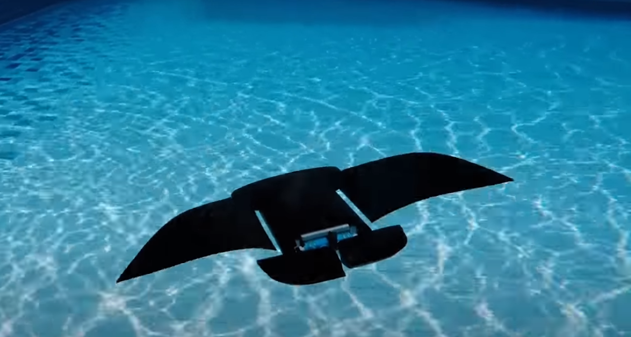
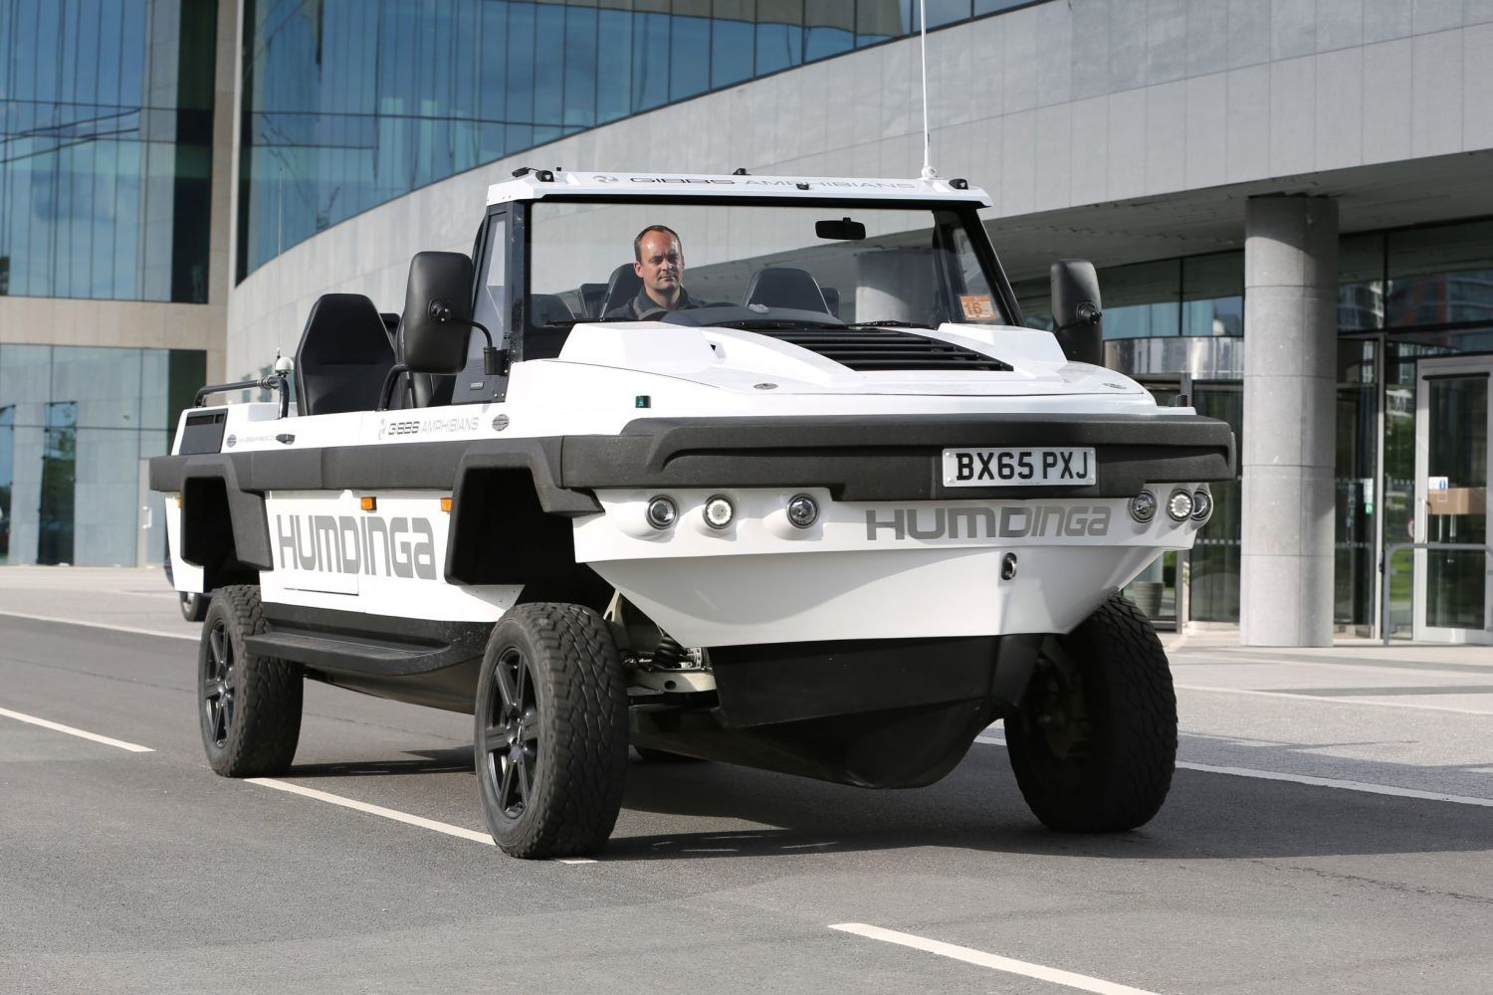
Rescue Bot- Dark Knight

Slide 5
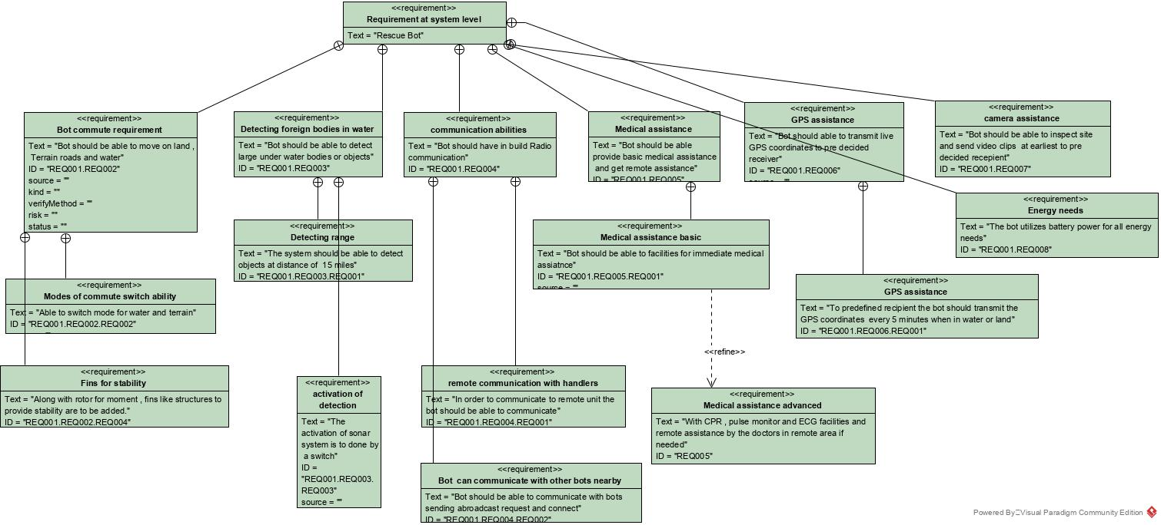
Requirement Diagram

Slide 6
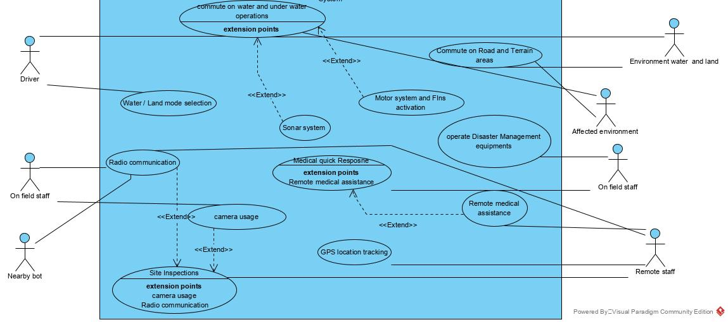
Use Case Diagram

Slide 7
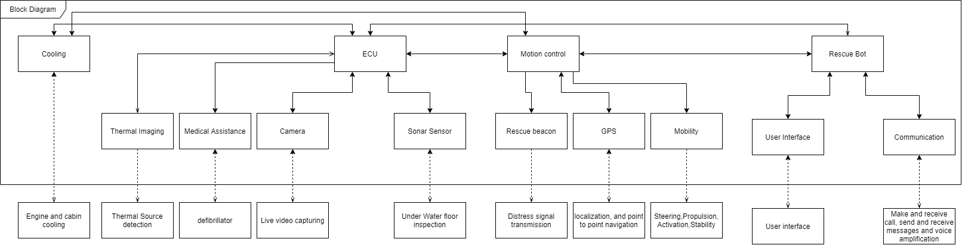
Internal Block Diagram

Slide 8
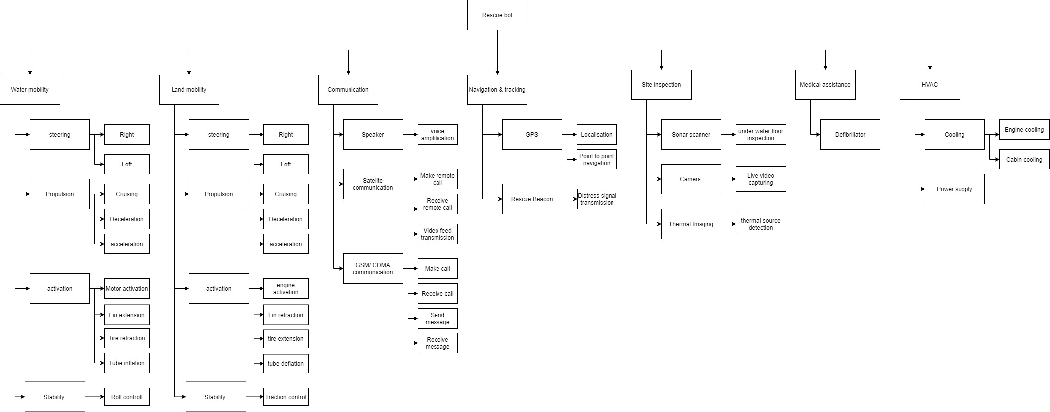
Functional Diagram

Slide 9
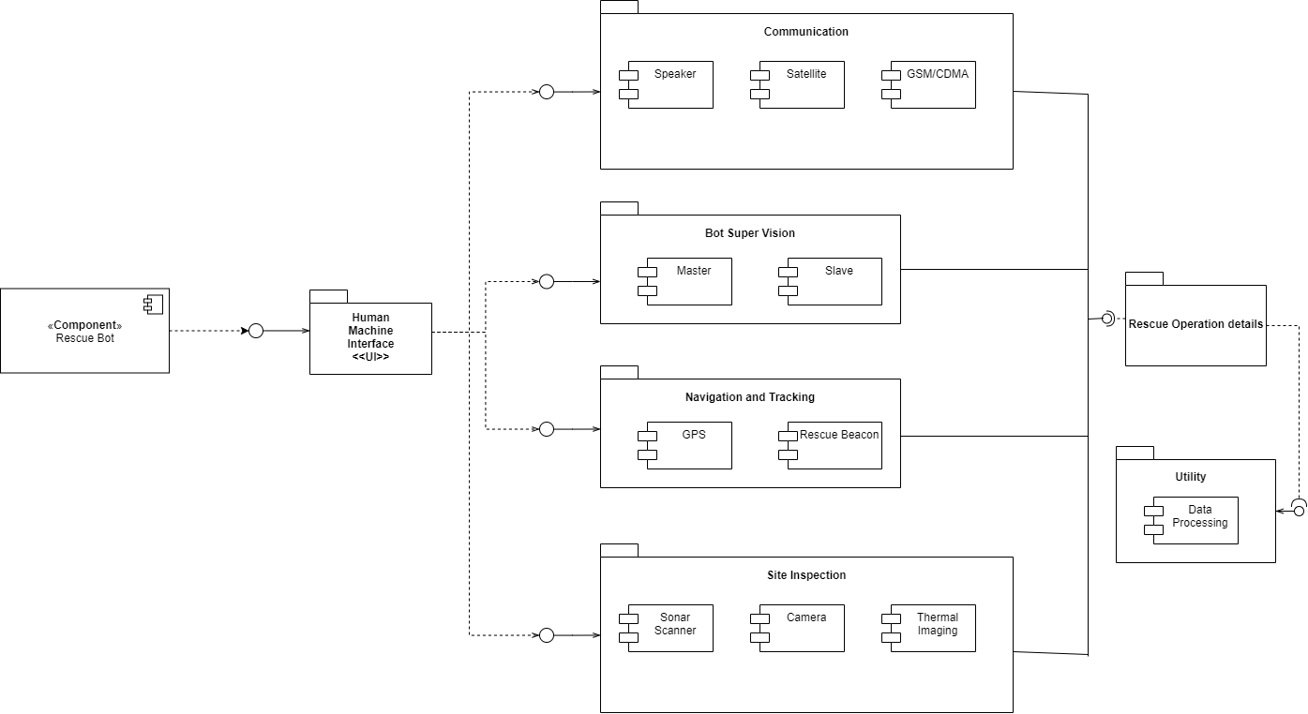
Component Diagram

Slide 10
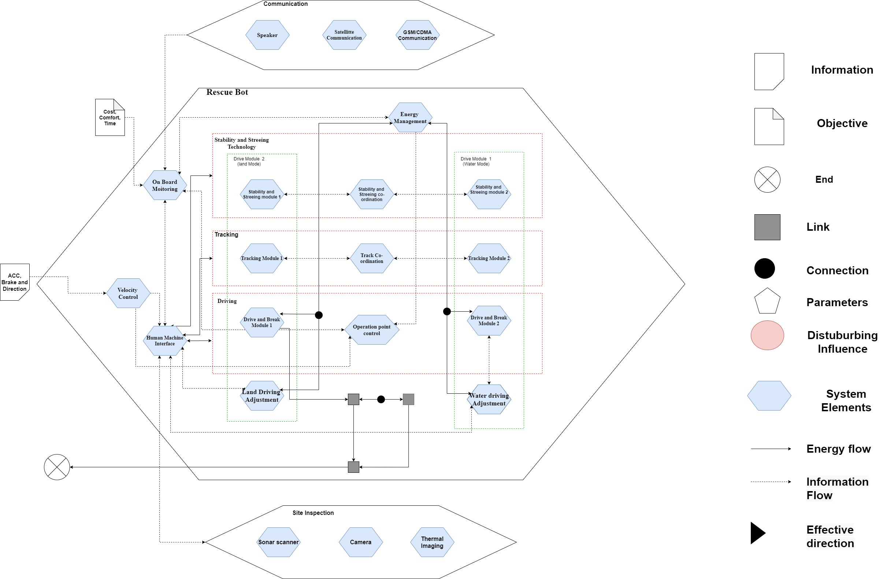
Activity Diagram

Slide 11
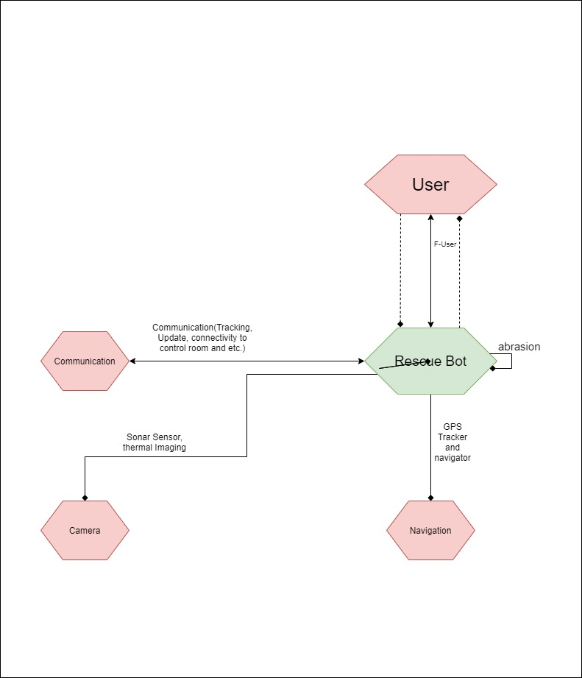
Application Scenario

Slide 12
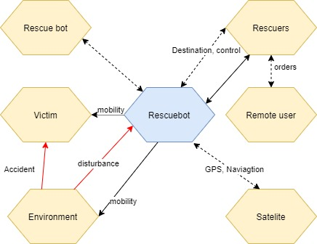
Environmental

Slide 13
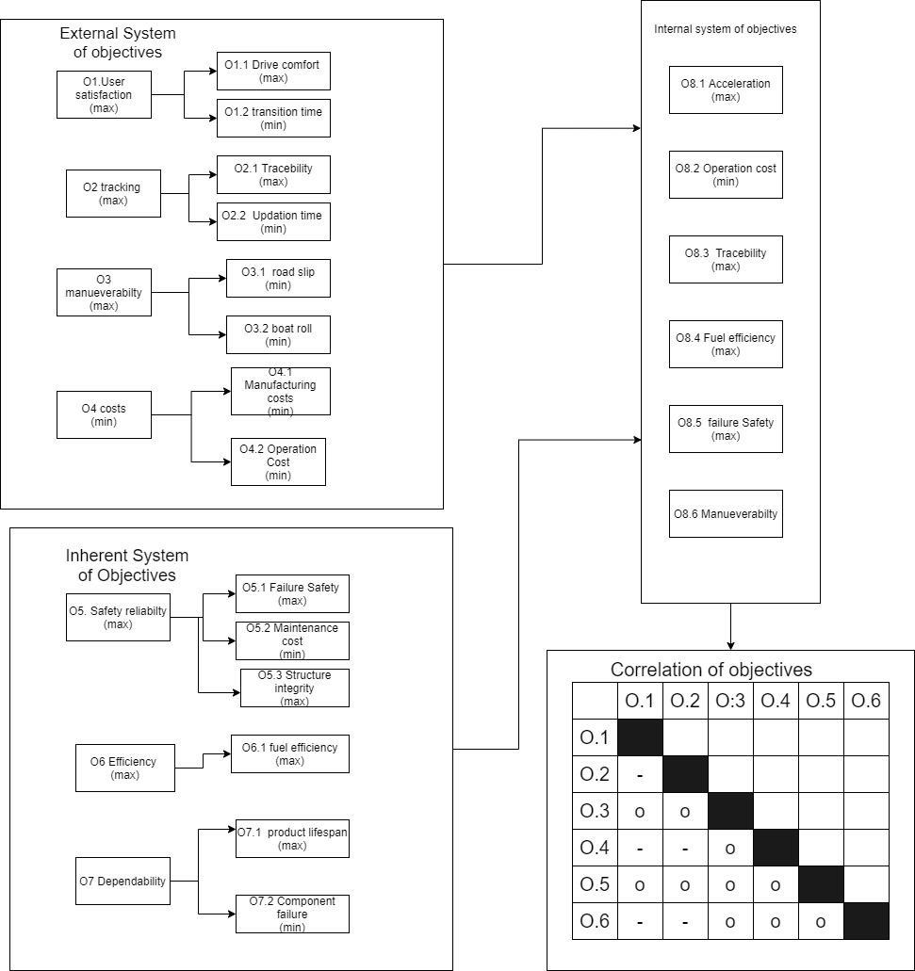
System of Objectives

Slide 14

Uppal Model

Slide 15
Decision Tree

Slide 16
References
Fig 1-https://www.google.com/amp/s/www.nbcnews.com/mach/amp/ncna827806
Fig 2-https://www.prnewswire.com/news-releases/gibbs-amphibians-set-to-establish-humdinga-assembly-subsidiary-in-qatar-803433636.html

